Slide 1
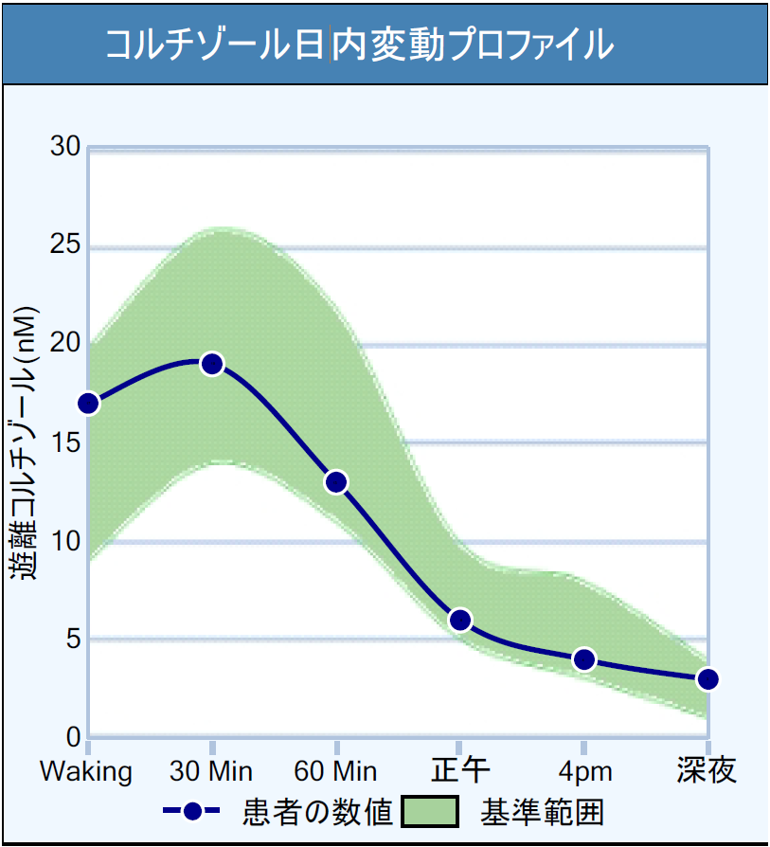

THE CORTISOL AWAKENING RESPONSE:
A CLINICAL OVERVIEW
OCTOBER 2024
Presented by
Lisa Canar, ND
.
Notes:
1

Slide 2

OBJECTIVE
Understand the importance of a healthy Cortisol Awakening Response (CAR) and how to evaluate and treat patients with an abnormal CAR.
2

Slide 3
OUTLINE
What is the Cortisol Awakening Response (CAR) and why is it important?
Who should be tested?
How to test the CAR: timing is essential
What does the CAR influence? What health concerns are associated with an abnormal CAR?
Factors that affect the CAR
Test interpretation
Treatment considerations for improving and optimizing the CAR
3

Slide 4

Overview:
What is the Cortisol Awakening Response?
4

Slide 5
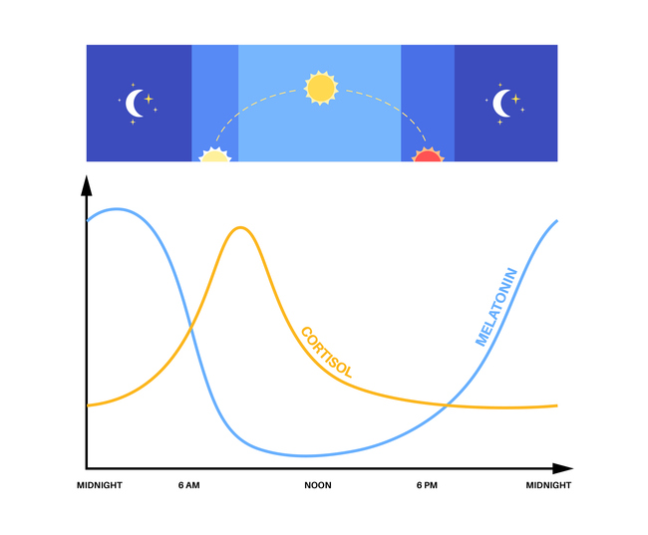
Overview: Circadian Rhythm and the CAR
5

Slide 6
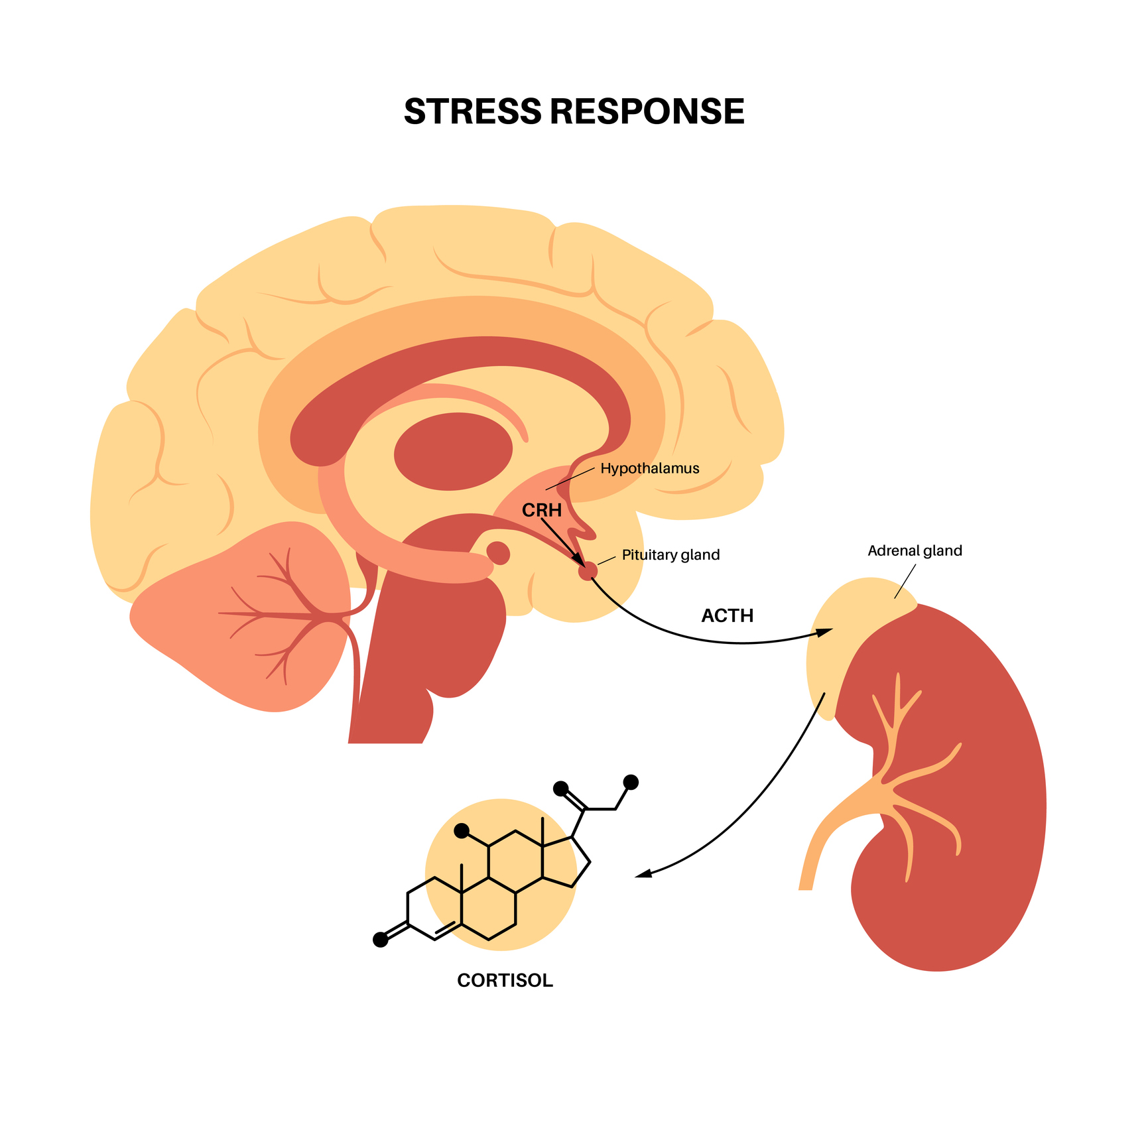
Overview: What is the CAR?
The Cortisol Awakening Response (CAR) is a fascinating phenomenon linked to the health of the Hypothalamic-Pituitary-Adrenal (HPA) axis.
6

Slide 7

Overview: What is the CAR?
A healthy CAR enhances alertness, cognitive awareness, physical mobilization, and energy levels, shaping how a person performs during the day ahead.
A healthy CAR also improves memory and mood, reduces inflammation, and promotes immune tolerance.
7

Slide 8
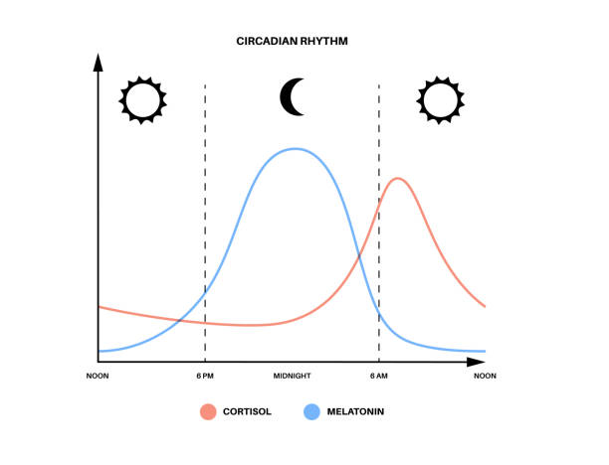
History and Overview
First studied in 1997, the CAR provides essential insights into the physiological state upon waking.
A healthy CAR is characterized by a 50% or greater increase in salivary cortisol within 30 minutes of awakening.
8

Slide 9

Overview: What is the CAR?
The CAR is a natural adaptive mechanism that influences mood, ability, and performance.
9

Slide 10
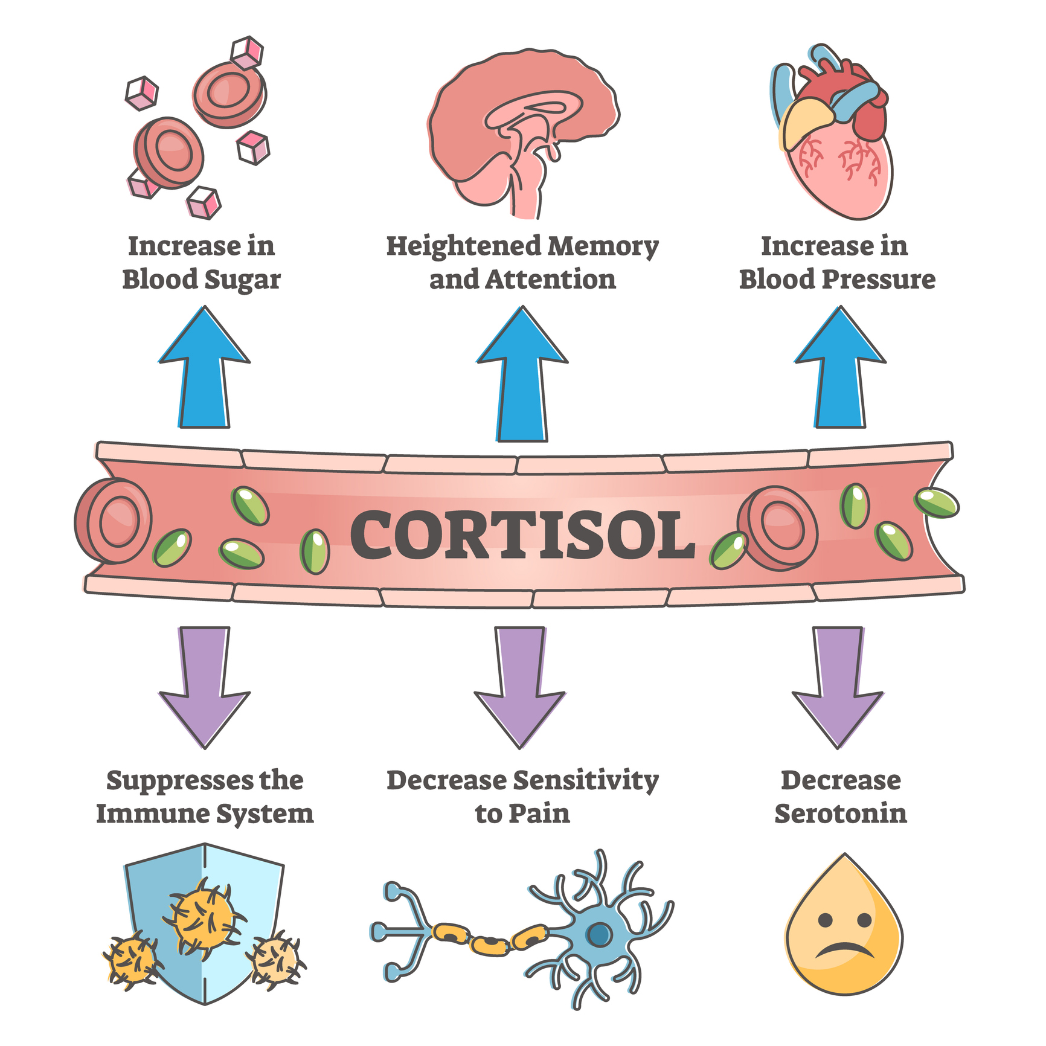
Overview: Functions of Cortisol
10

Slide 11

Functions of the CAR
Energy provision
Immune regulation
Cognitive functioning
  Executive functions
  Learning and memory
Brain plasticity
Emotion regulation
11

Slide 12

Perceived Stress and the CAR
Research suggests that anticipation of stress or workload can influence the magnitude of the CAR upon waking.
12

Slide 13
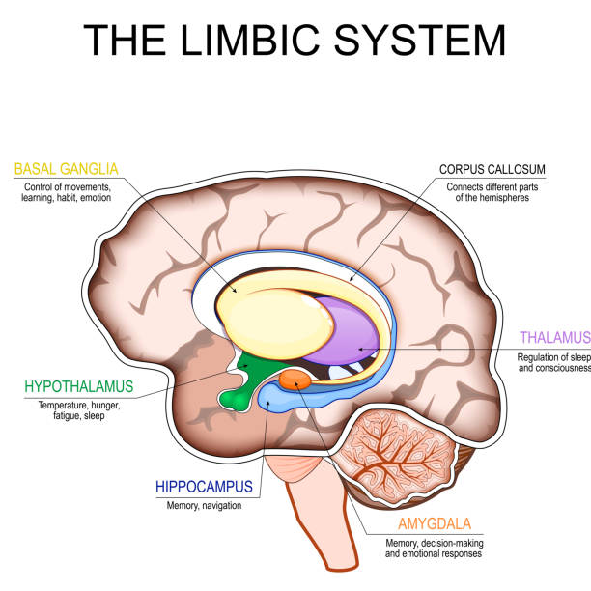
Role of the Hippocampus
The hippocampus is linked to a healthy CAR. Lower hippocampal volumes are associated with a blunted CAR.
13

Slide 14
Role of the Hypothalamus
The suprachiasmatic nucleus (SCN) in the hypothalamus acts as the body’s central clock. The CAR is amplified when light exposure stimulates the SCN, which increases adrenal sensitivity to adrenocorticotropic hormone (ACTH).
14

Slide 15

CAR and the Circadian Rhythm
The CAR is influenced by a complex interplay of internal circadian mechanisms, daily behaviors (awakening), and environmental cues (light exposure).
Notably, the CAR is physiologically distinct from a stress response.
While stress can induce cortisol production, the CAR is a natural part of our circadian rhythm.
15

Slide 16
Cortisol Awakening Response:
Who should be tested?
16

Slide 17

When to Order a CAR?
The CAR test is a valuable tool for assessing various health conditions.
Testing and understanding the CAR could lead to clarity and novel treatment options for hypertension, anxiety, PTSD, obesity, diabetes, and more.
17

Slide 18

Obesity and the CAR
Adults with obesity have a dampened or blunted CAR, low cortisol levels upon awakening, high cortisol levels in the evening, and a smaller overall change in cortisol levels throughout the day. Obese children also display low morning cortisol levels and a blunted CAR.
Dysfunction in the HPA axis is a known risk factor for metabolic diseases, such as obesity, and is closely related to negative health outcomes.
Testing and stabilizing circadian cortisol rhythms could be an effective approach to preventing childhood obesity.
18

Slide 19

Type 2 Diabetes and the CAR
The CAR is blunted in those with diabetes compared to those without diabetes; this association appears to be more significant in men and Caucasian populations.
Research suggests unhealthy changes in the cortisol circadian rhythm could occur before the development of diabetes.
Maintaining a healthier and more robust CAR could prevent the progression toward abnormal blood sugar metabolism and diabetes.
19

Slide 20

Depression and the CAR
Mild to moderate depression appears to be associated with a normal or heightened CAR, while severe or chronic depression is associated with a blunted CAR.
A long period of mental or physical stress, such as clinical depression, may reduce the number or sensitivity of cortisol receptors so the HPA axis becomes less responsive.
Elevated cortisol levels for a prolonged period due to the decreased sensitivity might eventually contribute to lower cortisol levels, which could explain the shift in the CAR as the severity of depression increases.
20

Slide 21

Depression and the CAR
The CAR could be a sensitive test to predict vulnerability to depression, and some clinicians refer to the CAR as “an index of one’s overall vulnerability to depression.”
A “flexible CAR,” characterized by a lower CAR on weekends and higher CAR on weekdays, could be associated with successful coping and a resilient psychological profile.
21

Slide 22

Chronic Stress and the CAR
Chronic stress is defined as repeated or constant exposure to psychological stressors.
The HPA axis is the most important neuroendocrine stress system, and the CAR is a core biomarker of HPA axis regulation. A flattened or blunted CAR is one of the most reliable and consistent markers of HPA axis dysfunction.
22

Slide 23

Inflammation and the CAR
Inflammatory symptoms such as fatigue or pain may be linked to a blunted CAR.
Cortisol plays a crucial role in managing inflammation. A robust release of cortisol upon awakening helps reduce inflammation; the absence of a cortisol awakening response may lead to discomfort and pain.
Understanding this link is vital for managing various chronic conditions effectively, including pain, GI issues, asthma symptoms, and profound fatigue.
23

Slide 24

Inflammation and the CAR
Testing the CAR is particularly helpful for patients with significant morning symptoms.
24

Slide 25

Cancer Risk and the CAR
For cancer patients or those with a family history of cancer, a CAR test can illuminate critical health patterns.
A flattened cortisol rhythm has been linked to early mortality, making routine CAR assessments vital for at-risk individuals.
Research indicates that healthy CAR functioning correlates with better cancer survival rates.
25

Slide 26
How to Test the CAR:
Timing is Essential
26

Slide 27

Saliva Collection
To accurately assess the CAR, the timing of saliva sample collection is crucial. It’s essential to inform patients about this process.
The initial saliva sample must be collected immediately upon waking (within 5 minutes), followed by samples at 30 minutes and 60 minutes post-awakening.
Encourage patients to use a timer or alarm to ensure timely collection at 30 and 60 minutes, as precision is key for reliable results.
27

Slide 28
Collection Schedule
When waking up – MORNING/FASTING Vial
30 minutes – note time of collection on Vial
60 minutes – note time of collection on Vial
NOON Vial – collect between 11am – 1pm; ideally one hour after eating the mid-day meal
AFTERNOON Vial – collect between 4-5pm
MIDNIGHT/BEDTIME Vial – collect before going to bed
28

Slide 29

Collection Guidelines
Patients should avoid food, coffee, significant conversation, exercise, and smoking until all three CAR samples are collected to prevent interference.
Testing on a typical day is ideal for consistent results, although unusual circumstances may warrant additional assessments.
29

Slide 30

Patient Education
Educate patients on the importance of timing and conditions surrounding the CAR test to ensure the best results possible.
If patients wake unusually early or late, suggest rescheduling the test for a typical day for an accurate and representative assessment.
Understanding the collection process empowers patients and enhances the overall effectiveness of CAR testing.
30

Slide 31
Assessing CAR Flexibility
The latest research suggests the assessment of CAR flexibility could be more clinically useful than assessing the CAR on only one day.
Those with significant day-to-day variability of external demands, e.g. a stressful workday vs. a leisurely weekend day, ideally display a flexible CAR that is more robust on workdays.
Research suggests a robust CAR on a workday is beneficially adaptive, while a robust CAR on a day of rest could be maladaptive.
Also, a blunted CAR on a workday could be more clinically concerning than a slightly blunted CAR on a day of rest.
Ensure patients report relevant life circumstances on each test day when assessing CAR flexibility.
31

Slide 32

Retesting and Monitoring
Regular monitoring of the CAR is important for long-term health, especially for those with prior diagnoses or concerning symptoms.
Recommend retesting every 3-4 months until optimal CAR levels are achieved. This ensures ongoing assessment of cortisol levels with changing life circumstances.
Once an optimal CAR is attained, transitioning to annual monitoring or more frequent checks based on symptoms is advisable.
32

Slide 33
What does the CAR influence?
33

Slide 34

What does the CAR influence?
Alertness
Energy levels
Blood sugar
Inflammation
Infection / recovery
Stress response / resilience
Immune tolerance / autoimmune response
Memory / cognitive function / mood
Cancer risk
34

Slide 35
Health Concerns Associated with an Abnormal CAR
ADHD / Anxiety / Depression
Asthma
Autoimmune disease
Chronic fatigue syndrome
Chronic infection / stress / pain / inflammation
Cognitive impairment
Coronary heart disease / hypertension
Insulin resistance / obesity / diabetes / metabolic syndrome
Post traumatic stress disorder (PTSD)
35

Slide 36
Health Concerns Associated with an Abnormal CAR
Addictive behaviors / alcohol consumption
Borderline personality disorder
Cushing’s disease
Developmental delay / preterm birth
Hypogonadism
Irritable bowel syndrome
Obstructive sleep apnea / sleep disorders
Premenstrual syndrome (PMS) / Premenstrual dysphoric disorder (PMDD)
Psychosis / schizophrenia
36

Slide 37
Factors that Affect the CAR
37

Slide 38

Overview: Factors that Affect the CAR
Long-term influences (trait-like)
  Sex and age
  Genetics
  Brain function
  Chronic stress
  Physical and mental health
  Shift work
  Chronotype
38

Slide 39

Overview: Factors that Affect the CAR
Regulatory influences (day-to-day)
  Workday vs. weekend
    Challenging events
    Daily obligations
  Ambient light
  Awakening time
    Circadian phase
  Cognitive anticipation
    Anticipation of day ahead
    Prospective memory activation
  Prior day experiences
    Adverse events
    Negative affective states
39

Slide 40
Common Factors Affecting the CAR
Chronic stress / psychological burnout
Chronic pain / infection / inflammation
Anticipated daily activities / workload
Sleep deprivation / impaired sleep / sleep apnea
Night-time darkness / melatonin levels
Early morning and daytime light exposure
Waking time / chronotype
Traumatic brain injury
Suppressive medications (steroids, opiates, Accutane, aspirin)
40

Slide 41
Test Result Interpretation
41

Slide 42
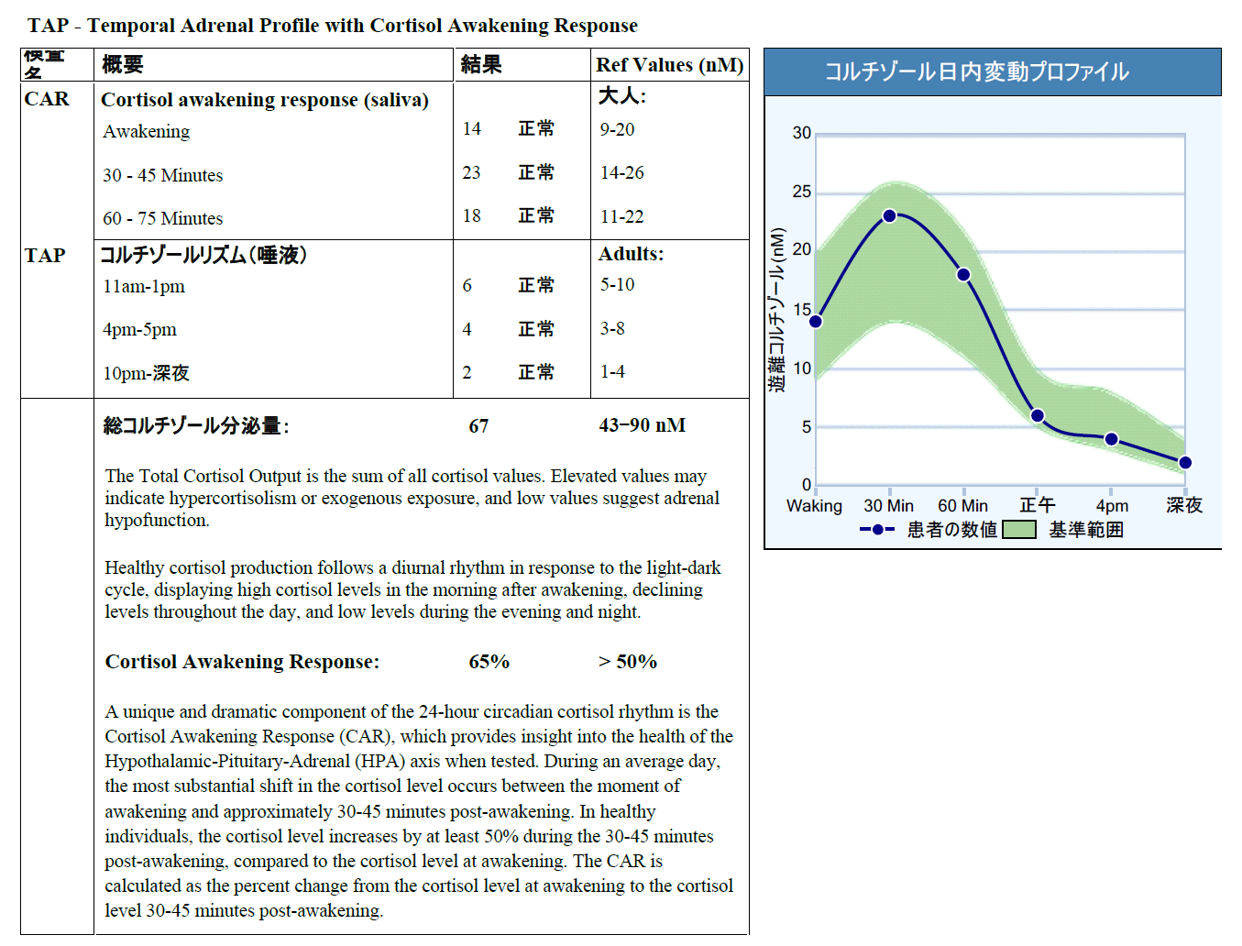
Test Interpretation – Normal CAR
42
Notes:
The ideal cortisol awakening response should be at least 50% higher at 30 minutes, as compared to the cortisol result at waking. The ideal response should then decline.
The cortisol result at 60 minutes should be lower than the cortisol result at 30 minutes.
The green reference range on the report illustrates an ideal cortisol awakening response.

Slide 43
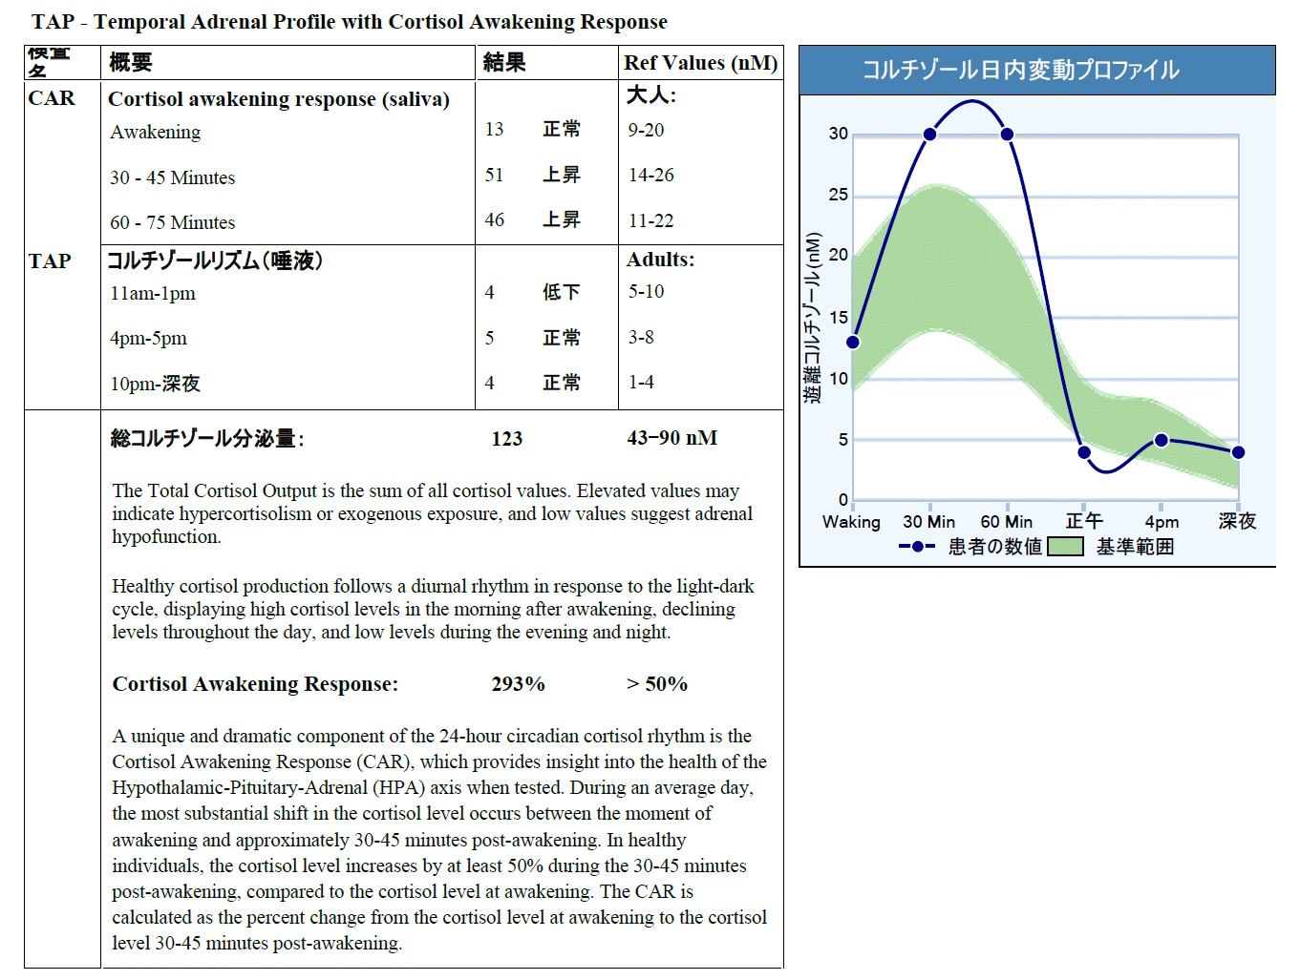
Test Interpretation – Elevated CAR
43
Notes:
This report shows elevated results at 30 minutes and 60 minutes, so this cortisol awakening response is higher than optimal.
This cortisol awakening response also lasts longer than an ideal response. The ideal response should decline more and sooner after the 30-minute time point.

Slide 44
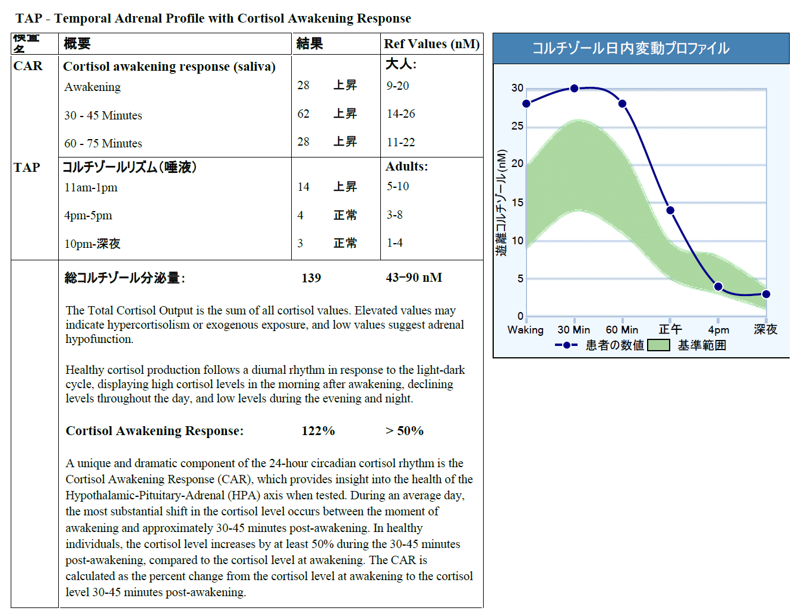
Test Interpretation – Elevated Cortisol
44
Notes:
This report shows elevated cortisol results at waking, 30 minutes, 60 minutes, and noon.
The increase from the cortisol at waking to the cortisol at 30 minutes is adequate (> 50%), however the cortisol result at waking is higher than it should be at that time.
The cortisol results at 60 minutes and noon also remain elevated.

Slide 45
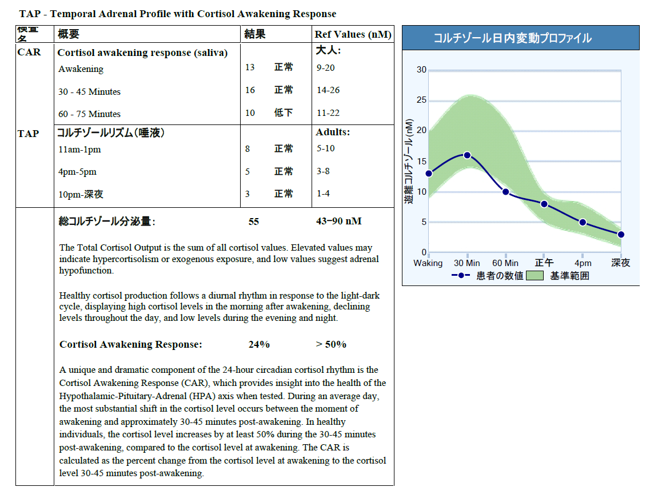
Test Interpretation – Low CAR
45
Notes:
This report shows a normal waking cortisol result, and a small increase of 24% at the 30-minute time point.
This cortisol awakening response is low. The cortisol result at 30 minutes should be at least 50% higher than the cortisol result at waking.

Slide 46
Treatment Considerations
46

Slide 47
Treatment Considerations for a Low CAR
Identify and treat the cause
Natural light / movement / exercise in the morning
Sleep support / sleep hygiene
Determinants of health / daily routine / medications
Stress management
Adrenal restoration – nutrient support, adaptogens, glandulars, precursor hormones
Support brain health
Support cellular energy production / mitochondria
Balance blood sugar
47

Slide 48
Treatment Considerations for an Elevated CAR
Identify and treat the cause
Stress management / mindfulness training
Mood and brain support
Appropriate exercise
Determinants of health / daily routine / stimulants
Rest and relaxation
Reduce inflammation
Sleep support / calming nutrient support
Adrenal restoration – nutrient support, adaptogens
Balance blood sugar
48

Slide 49
Patient Case Study
49

Slide 50
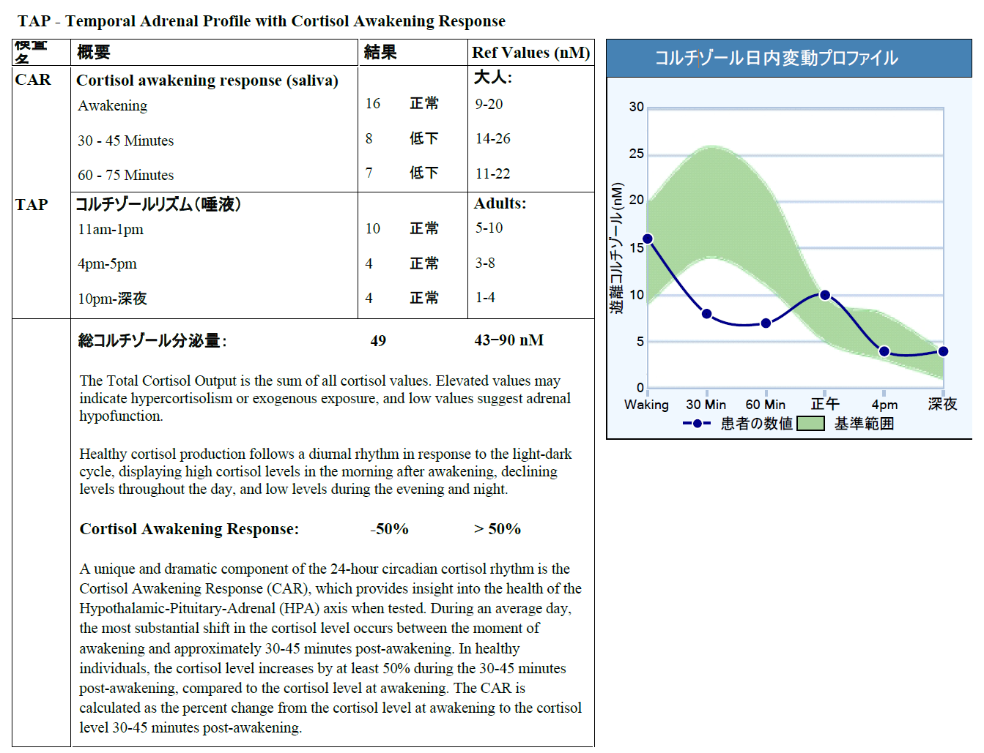
Case Study – 38-year-old woman
Difficulty getting up in the morning
50

Slide 51
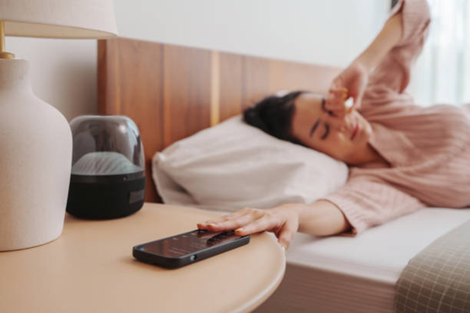
Case Study – 38-year-old woman
This patient has a blunted Cortisol Awakening Response, which can be associated with:
Chronic stress
Adrenal fatigue
HPA axis dysfunction
Depression
Obesity
Type 2 Diabetes
Stress-related disorders, including burnout, PTSD, and chronic fatigue syndrome
51

Slide 52
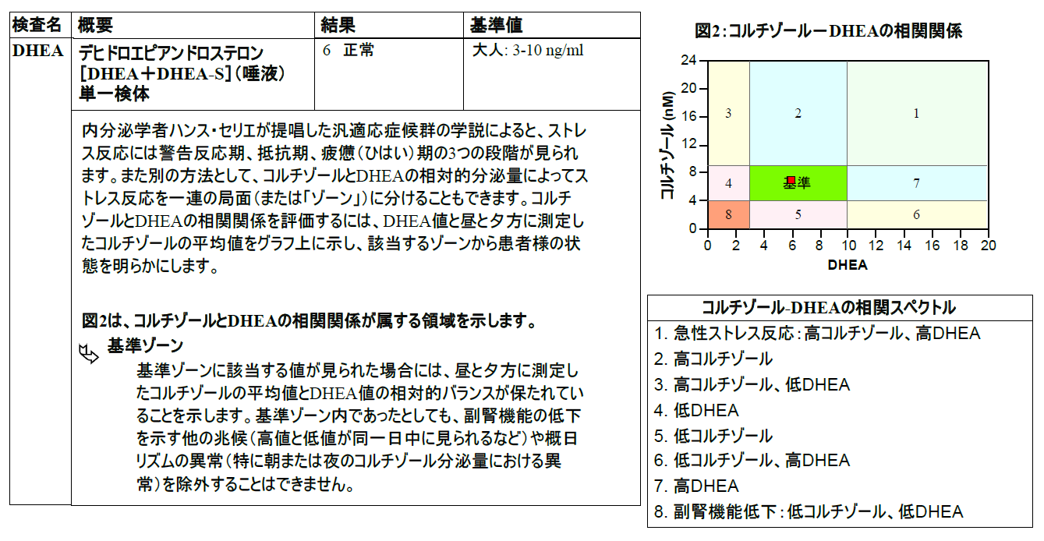
Case Study – 38-year-old woman
52

Slide 53
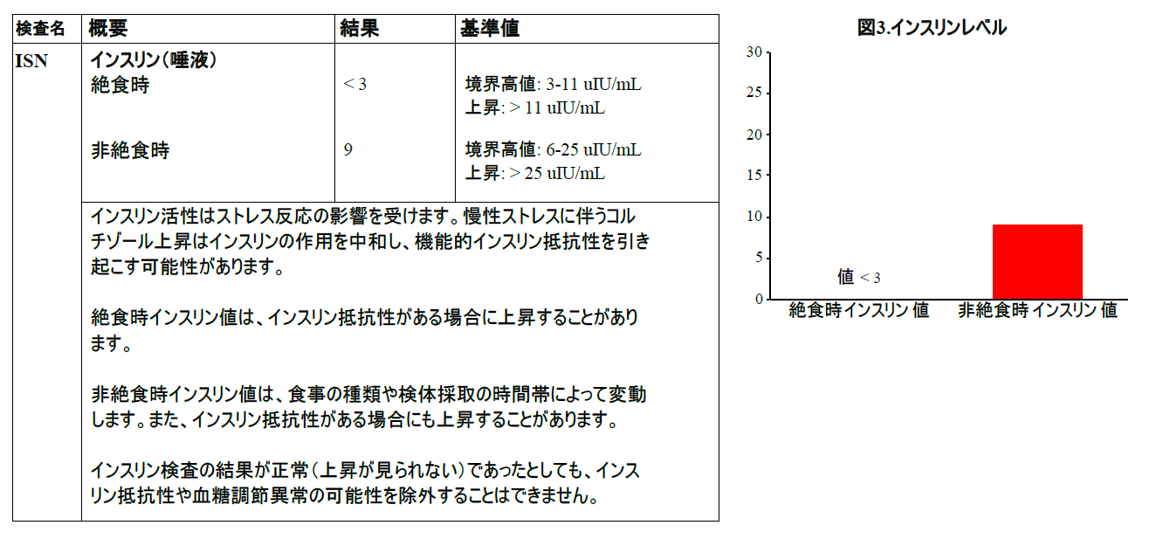
Case Study – 38-year-old woman
53

Slide 54
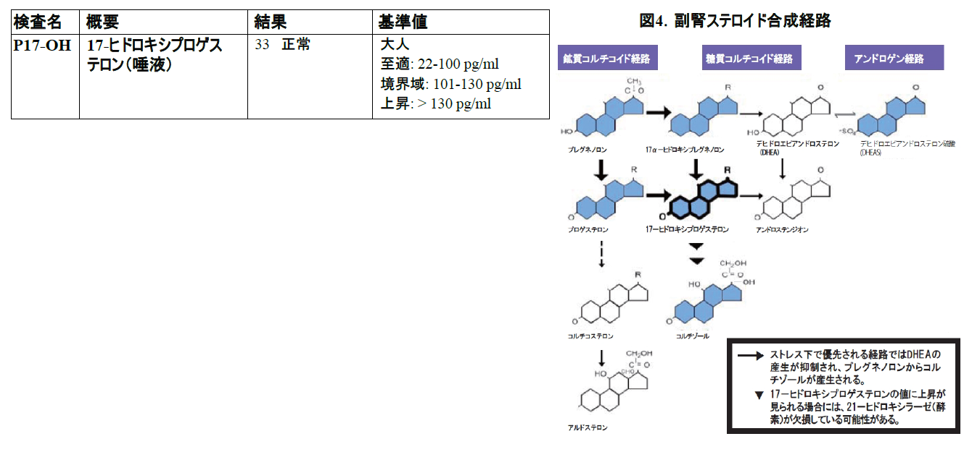
Case Study – 38-year-old woman
54

Slide 55
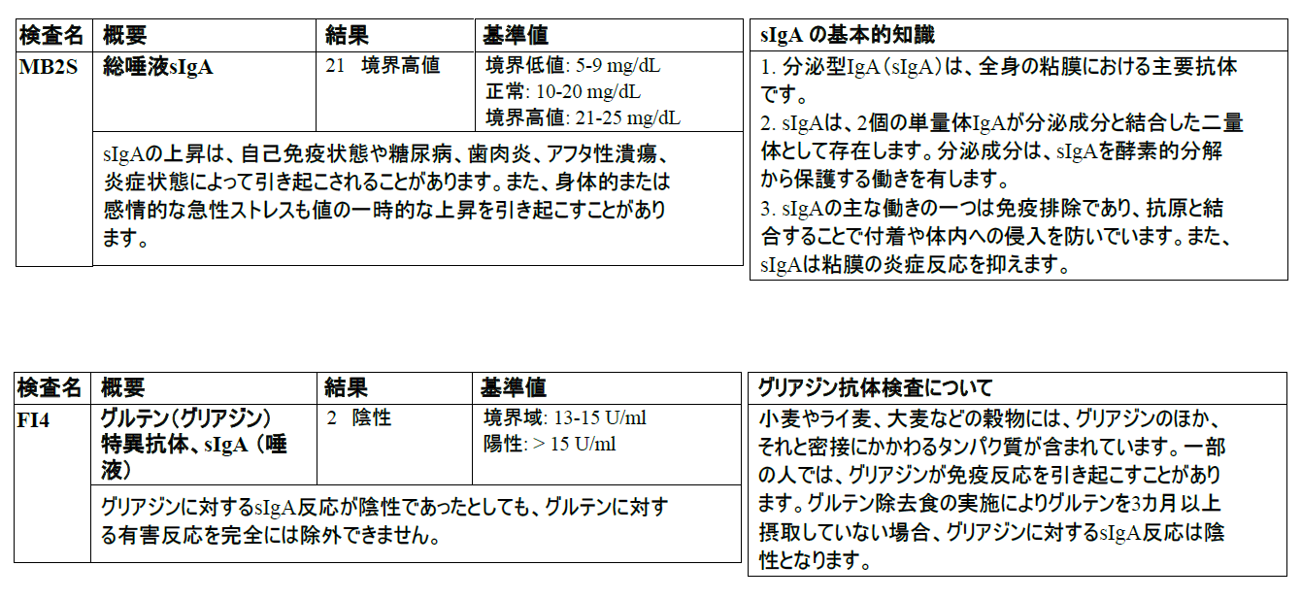
Case Study – 38-year-old woman
55

Slide 56
Case Study – 38-year-old woman
To support this patient’s health:
Reduce inflammation
Balance blood sugar; improve insulin sensitivity
Manage chronic stress / stress-related disorders
Optimize the patient’s circadian rhythm with regular routines, such as consistent bedtime, time of waking, exercise timing, and meal times
Support optimal sleep hygiene, including avoiding bright light at night and increasing exposure to sunshine upon waking and during the day
Modulate the HPA axis with adaptogens (e.g., Ashwagandha) and other Adrenal Support
56

Slide 57
Resources
57

Slide 58
Resource Guides (PDF)
An Introduction to the Cortisol Awakening Response Test – DiagnosTechs 2024
Health Concerns Associated with an Abnormal Cortisol Awakening Response – DiagnosTechs 2024
Factors That May Affect the Cortisol Awakening Response – DiagnosTechs 2024
Treatment Considerations to Optimize the Cortisol Awakening Response – DiagnosTechs 2024
58

Slide 59
Resource Articles
Introducing the Cortisol Awakening Response Test: A Tool for Managing Chronic Stress, Depression, Obesity, and Type 2 Diabetes – DiagnosTechs 2024
Synergistic Nutrients for Adrenal Support – DiagnosTechs 2023
Cortisol – The Stress Hormone – DiagnosTechs 2023
A Foundational Approach to Adrenal Restoration – DiagnosTechs 2015
59

Slide 60
References
Pruessner JC, Wolf OT, Hellhammer DH, et al. Free cortisol levels after awakening: a reliable biological marker for the assessment of adrenocortical activity. Life Sci. 1997;61(26):2539-49. doi:10.1016/s0024-3205(97)01008-4.
Clow A, Hucklebridge F, Thorn L. The cortisol awakening response in context. Int Rev Neurobiol. 2010;93:153-175. doi:10.1016/S0074-7742(10)93007-9
Smyth N, Thorn L, Hucklebridge F, et al. Detailed time course of the cortisol awakening response in healthy participants. Psychoneuroendocrinology. 2015;62:200-203. doi:10.1016/j.psyneuen.2015.08.011
Stalder T, Kirschbaum C, Kudielka BM, et al. Assessment of the cortisol awakening response: Expert consensus guidelines. Psychoneuroendocrinology. 2016;63:414-432. doi:10.1016/j.psyneuen.2015.10.010
Law R, Clow A. Stress, the cortisol awakening response and cognitive function. Int Rev Neurobiol. 2020;150:187-217. doi:10.1016/bs.irn.2020.01.001
Bowles NP, Thosar SS, Butler MP, et al. The circadian system modulates the cortisol awakening response in humans. Front Neurosci. 2022;16:995452. doi:10.3389/fnins.2022.995452
Stalder T, Oster H, Abelson JL, et al. The cortisol awakening response: regulation and functional significance. Endocr Rev. Published online August 23, 2024. doi:10.1210/endrev/bnae024
60

Slide 61
Thank you for attending!
We look forward to hearing from you soon.
61
Notes:
61

